Slide 1


Preterm and Post-term Newborns
Chapter 13
Niomi Quinteros, BSN, RN

Slide 2
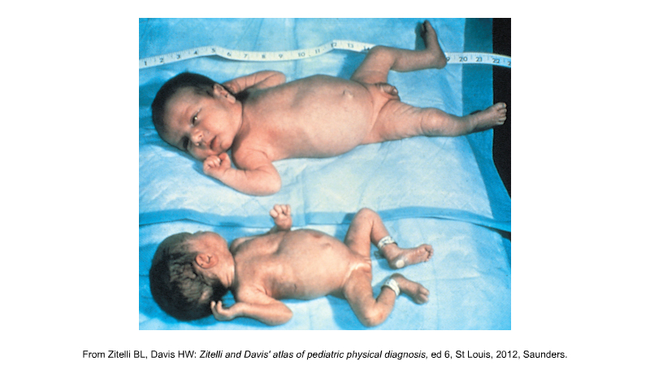
LGA
Large for Gestational Age
Over 8.8 pounds (4000 g)
SGA
Small for Gestational Age
(Can be low birthweight)

Slide 3
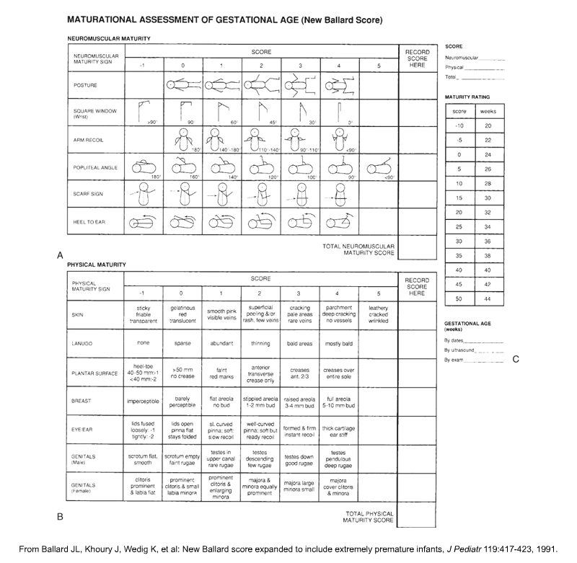
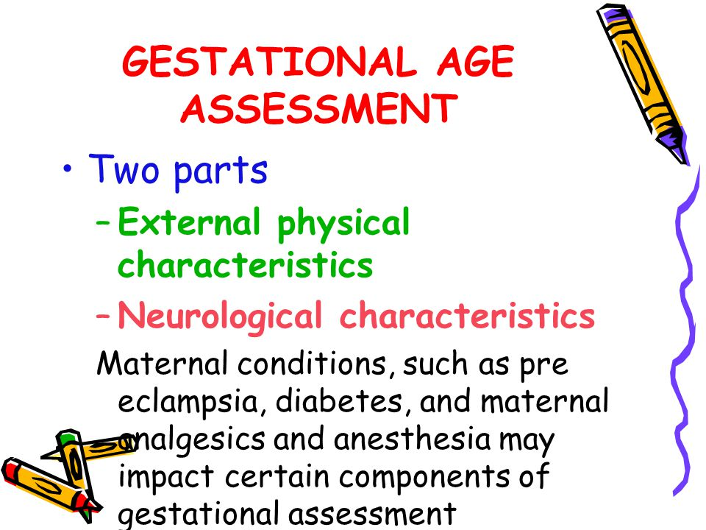

Slide 4

Preterm Newborn
Gestation > 37 weeks

Slide 5

Causes – Preterm Birth
Multiple births
Maternal Illness
Hazards of Pregnancy
Poverty
Smoking
Alcohol
Drug use
Prenatal care a MUST!

Slide 6
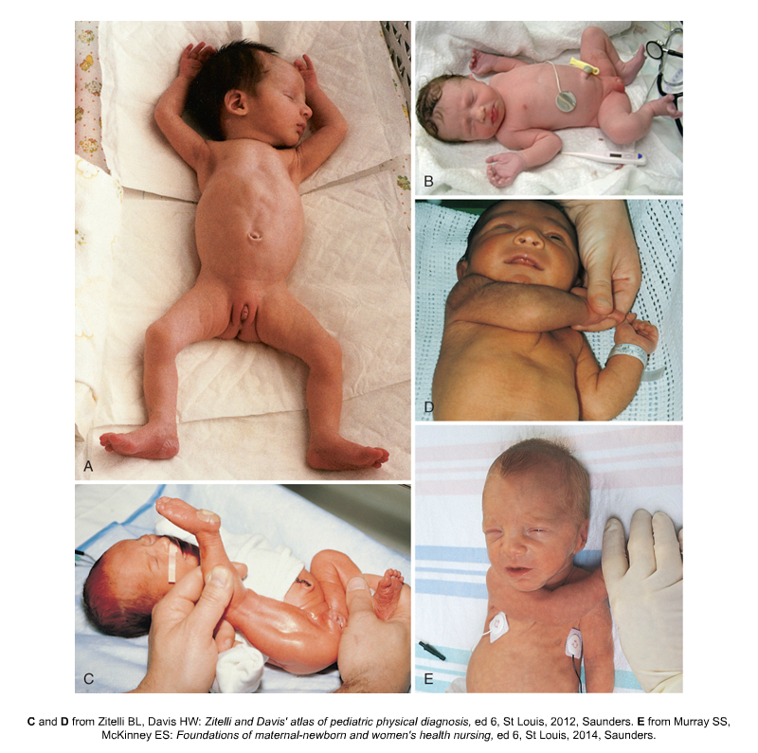
Also applies to low - birthweight
Preterm Characteristics
Skin: Transparent & loose
Superficial Veins (abdomen & scalp)
Lack of SQ fat
Lanugo on forehead, shoulders, arms
Vernix caseosa abundant
Extremities appear short
Few creases on soles of feet
Protruding abdomen

Slide 7
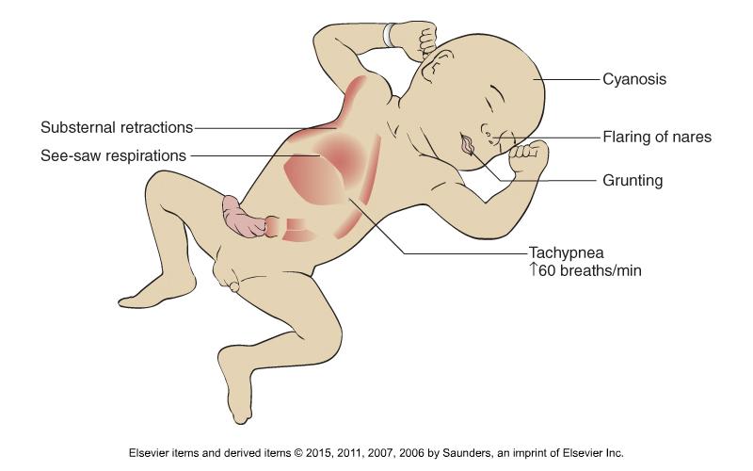
Respiratory
Causes
Oxygen
RDS
Surfactant
Vital Signs / Cluster Care
Apnea / Bradycardia
Neonatal Hypoxia
Pulse oximetry

Slide 8

Temperature
Causes
Cold Stress
Skin Probe
Radiant Warmer

Slide 9
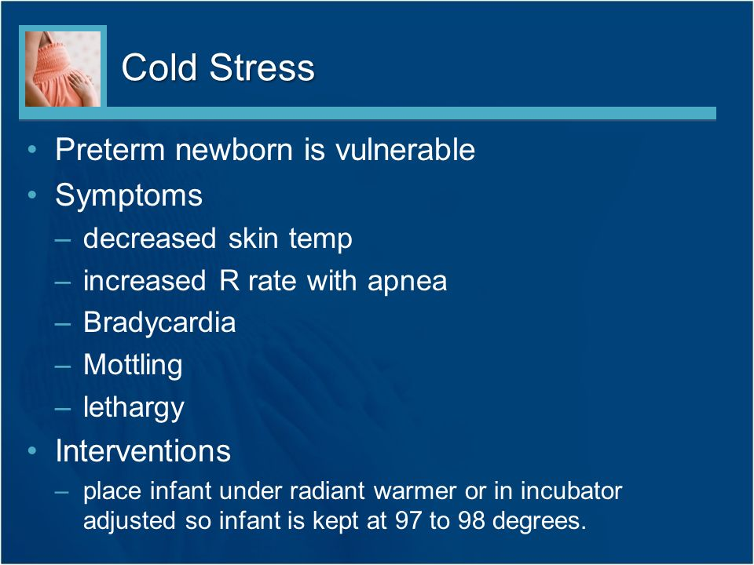
Cold Stress

Slide 10

Hypoglycemia
Causes
Signs
Glucose monitoring
Feedings

Slide 11
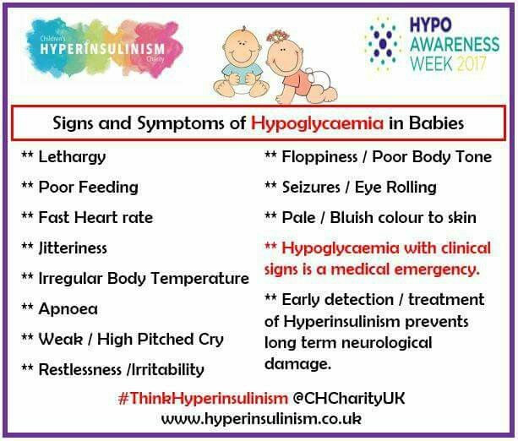
Hypoglycemia Signs and Symptoms

Slide 12
Bleeding
Causes
Nursing Care
Monitor neurological status
Bulging fontanelles, lethargy, poor feeding, and seizures (ICP)
Slight Fowler’s position
Cluster care

Slide 13

Nutrition
Causes
Small stomach capacity
Immature sphincter muscles
Immature suck and swallow
Inadequate store of nutrients
Feedings
Gavage
Problem: Immature Kidneys
Causes
Nursing Care
I&O
Assess fontanelles, turgor, and weight

Slide 14
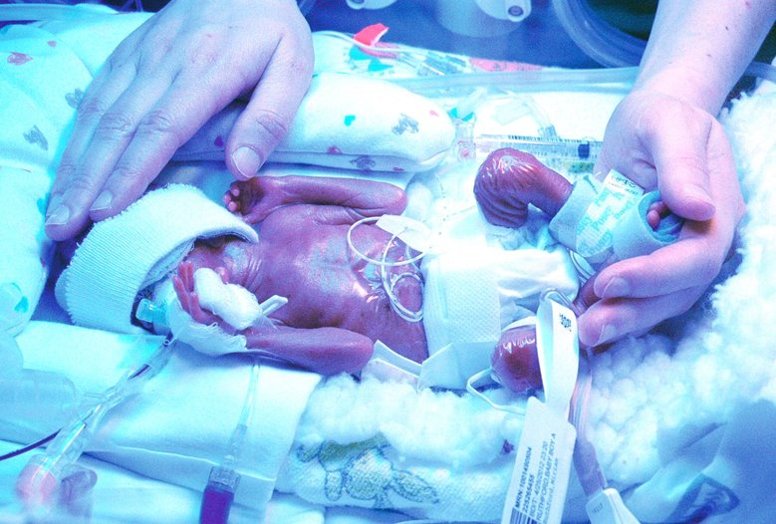

Jaundice
Causes
Immature liver
Nursing Care
Observe infant’s skin, sclera, and mucous membranes for jaundice
Phototherapy
At risk for brain damage

Slide 15
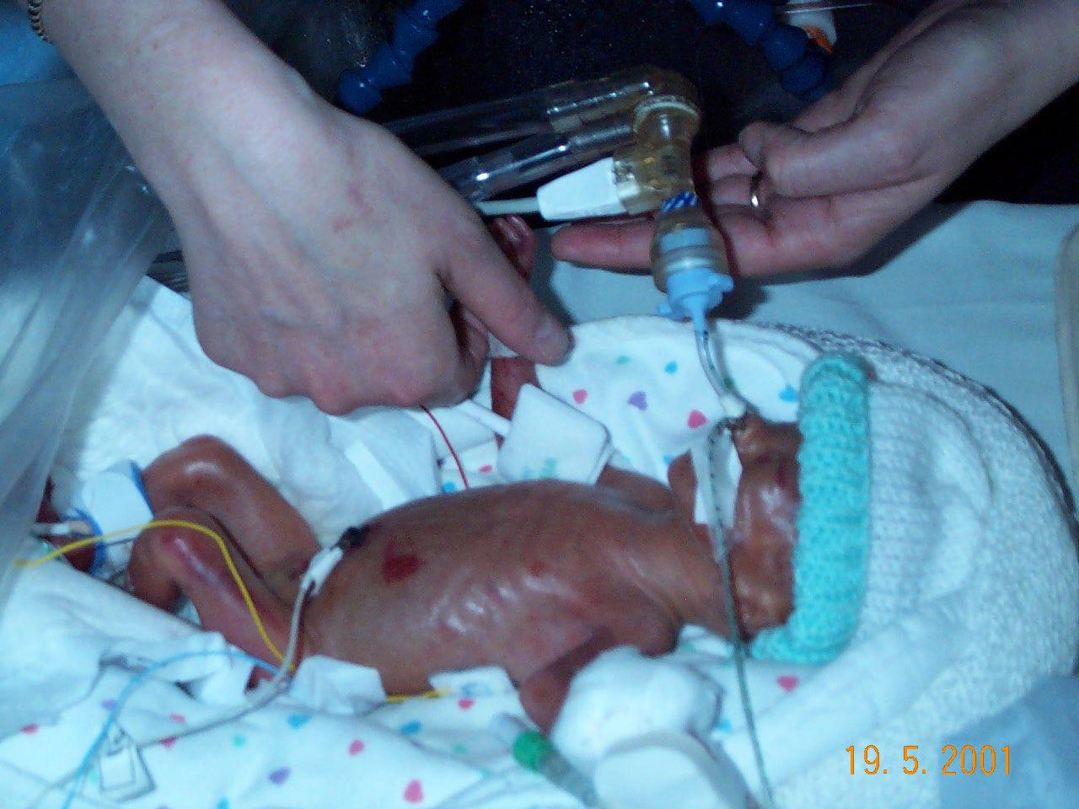
Nursing Goals for Preterm Infant
Box 13-1

Slide 16
Nutrition
Feedings
Bowel Sounds
Meconium
Supplemental Vitamins
Thermoregulation
Incubator / Warmer
Kangaroo Care
Special Needs
Positioning: side-lying or prone
Prognosis & Family Reaction

Slide 17
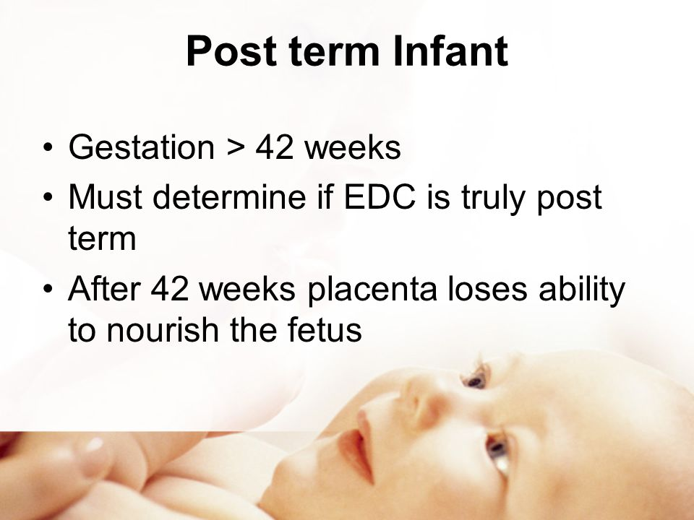

Slide 18
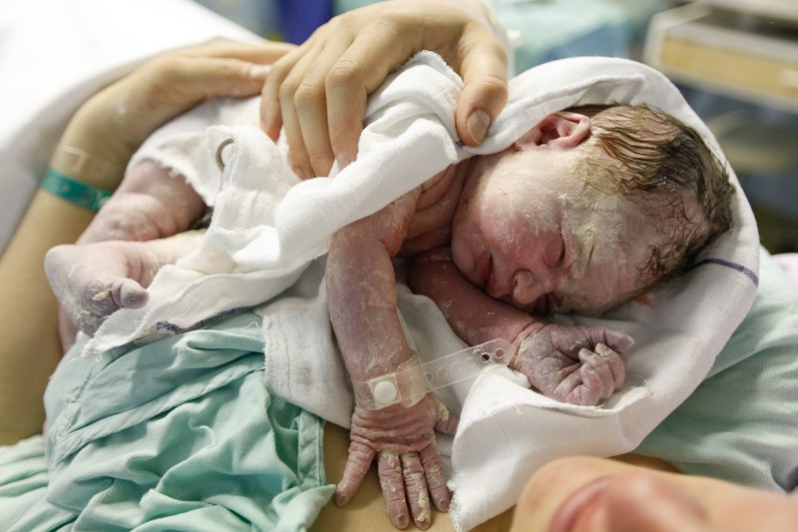
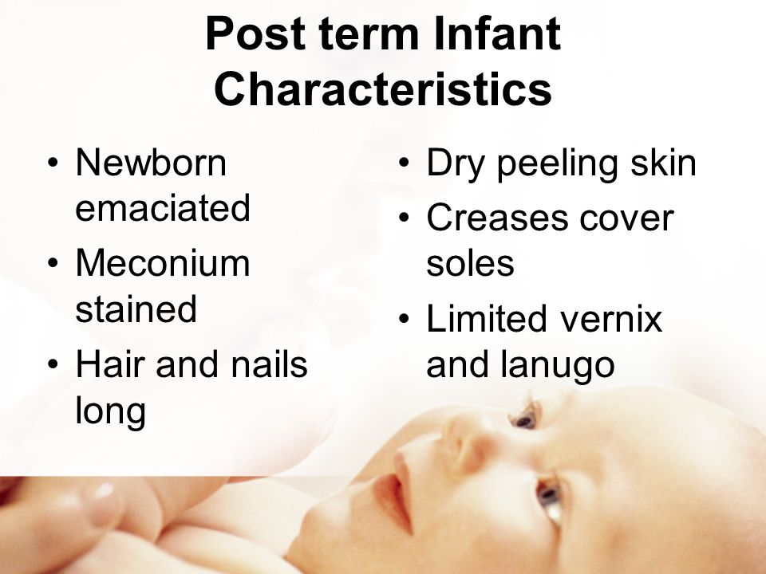
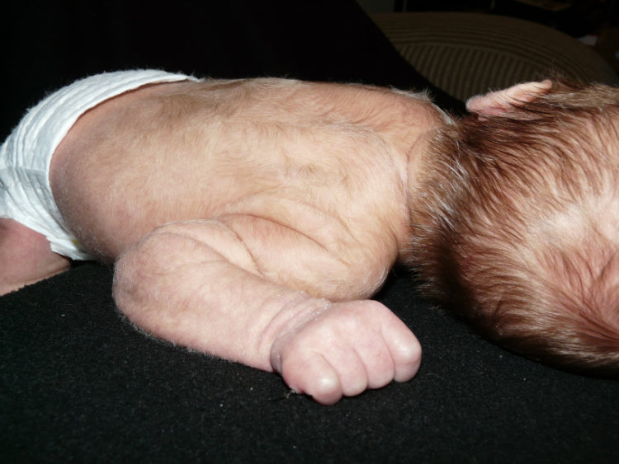
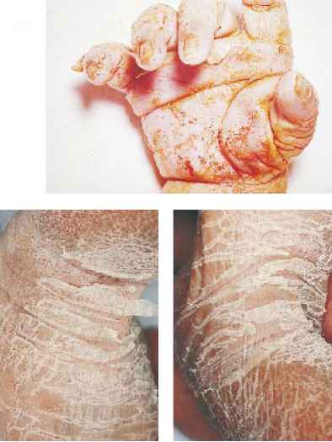
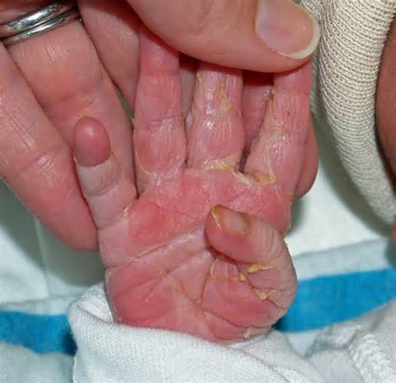


Slide 19
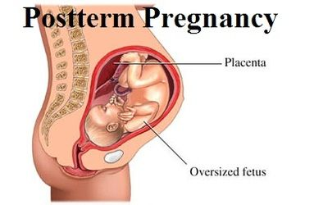
Nursing Care & Discharge Planning / Teaching
Post-term Newborn Problems
Asphyxia
Meconium aspiration
Poor nutritional status
Polycythemia
Difficult deliveries
Birth defects
Seizures

